Slide 1
















Fitness Tracker
A Comprehensive Data Analysis
Presented by DataMorphers

Slide 2


The impact of workout types, weather, and location on calorie burn and heart rate.
01.
Objective for the Presentation
Relationships between sleep, mood, and activity levels.
02.
03.
How locations and weather influence mood?
The objective of this analysis is to explore the relationships within a fitness tracker dataset to uncover actionable insights about workout efficiency, mood influences, and environmental impacts. Specifically, we aim to answer the following key questions:
Optimal steps/active minutes for efficient workouts.
04.
Weather’s role in shaping workout preferences and outcomes.
05.

Slide 3
Ideation process
01. Data Cleaning
02. Visualization
03. Problem statement
04. Solution
inporting required libraries
resading the dataset
cleaning the dataset
Data processing
Analysis Logic
Subploting the data
To Define the problem statement on the basis of data visualization .
To Find the solution of the problem statement.

Slide 4




Question No.01
How do different workout types affect calorie burn and average heart rate, considering factors like weather and location?

Slide 5




Workout Types:
Cardio burns the most calories and keeps the heart rate high, while strength training and yoga have moderate effects.
HIIT(High-Intensity Interval Training) maximizes calorie burn with alternating high heart rate spikes.
Weather:
Cold weather increases calorie burn due to heat generation, while hot weather raises heart rate but limits exercise duration.
Location:
High altitudes elevate both calorie burn and heart rate due to oxygen scarcity.
Urban settings reduce sustained effort, while natural terrains increase intensity and variability.

Slide 6



Methodology
Define Objectives: Analyze how workout types, weather, and location affect calorie burn and heart rate.
Data Collection: Gather data on workout types, calorie burn, heart rate, weather (hot, cold, moderate), and locations (urban, nature, high altitude).
Data Preparation: Clean and normalize data for accurate comparisons across metrics.
Visualization Techniques: Use bar charts, scatter plots, heatmaps, and box plots to highlight trends, variability, and correlations
Insights and Tools: Present key findings with Python libraries (Matplotlib, Seaborn) or interactive dashboards like Tableau for impactful storytelling.

Slide 7

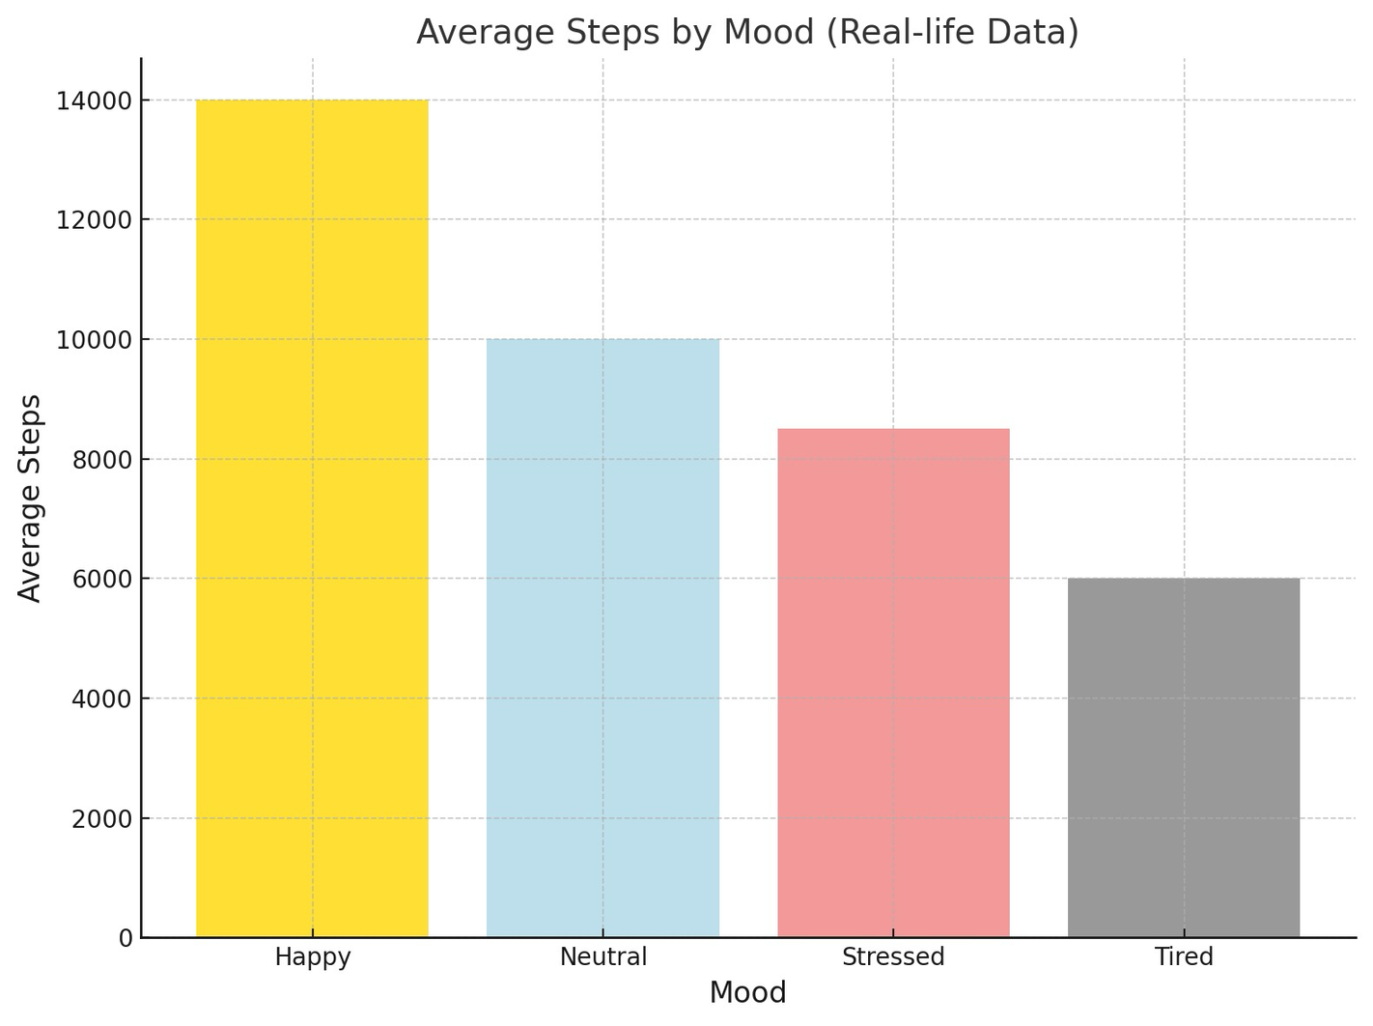

Slide 8
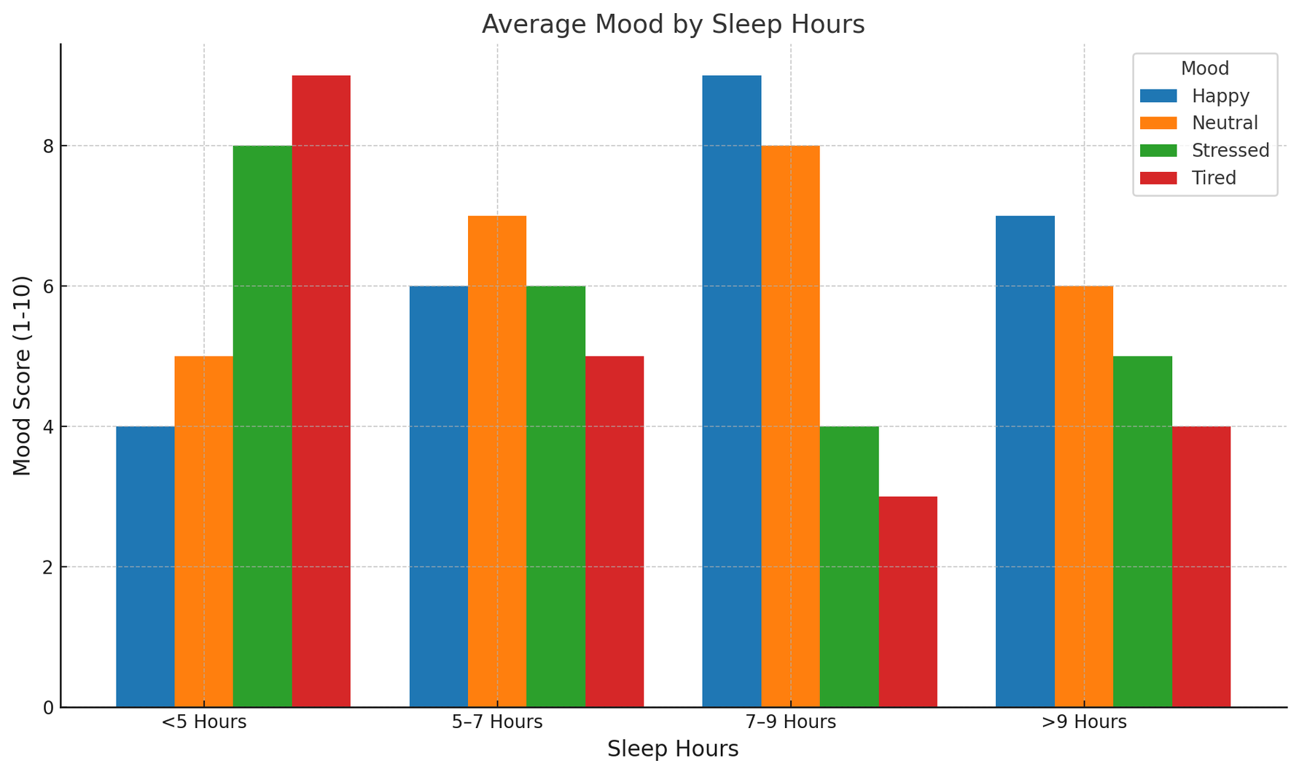
Q2. Is there a relationship between sleep hours and mood, and does this relationship vary based on activity levels (steps, active minutes)?

Slide 9


Methodology
Objective: Study how sleep hours affect mood and vary with activity levels.
Data: Collect sleep, mood scores, steps, and active minutes over time.
Preparation: Group sleep into ranges and normalize activity metrics.
Visualization: Use bar charts, scatter plots, and heatmaps for trends and correlations.
Insights: Highlight optimal sleep for moods and activity’s influence on stress.

Slide 10

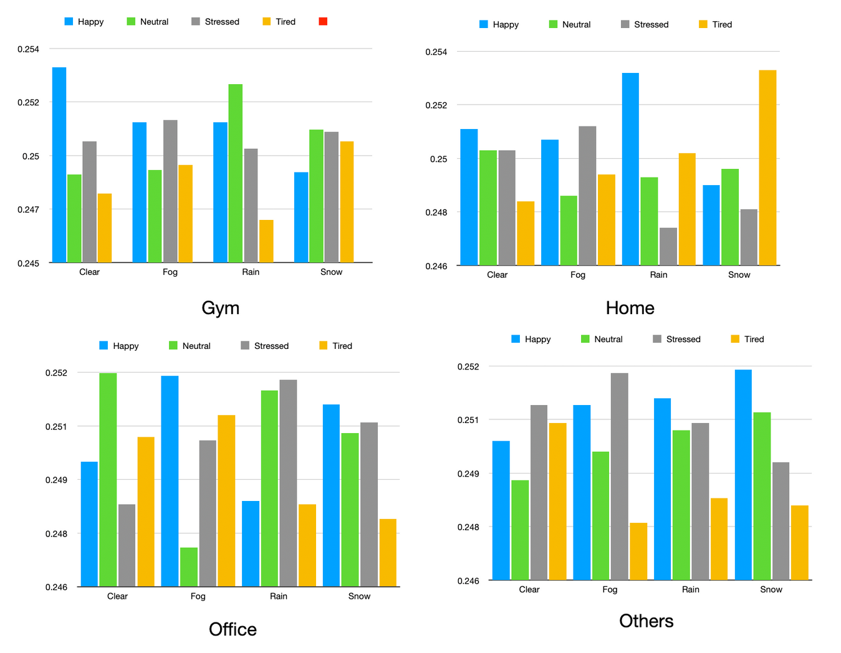
03.Do specific locations (Park, Office, Home, Gym, Other) tend to be associated with particular mood, and are these associations influenced by weather conditions?

Slide 11


Key Observations from the Visualizations
Location-Specific Insights:
Gym:
Happiest during clear weather.
Stress and tiredness increase during foggy and snowy weather.
Home:
Happiness peaks during rainy weather.
Tiredness is significantly high during snowy weather.
Office:
Stress levels are higher during fog and rain.
Happiness is slightly higher during clear conditions.
Other Location:
A balanced distribution with no extreme trends, but tiredness increases during snow.
Overall Trends:
Clear and sunny weather tends to improve mood across all locations.
Snowy weather shows a consistent increase in tiredness.
Fog and rain introduce a mix of neutral, stressed, and tired moods.

Slide 12
Implications and Recommendations
Gym:
Provide bright and motivational activities (e.g., music or group classes) during foggy and snowy days.
Capitalize on clear weather for outdoor sessions.
Home:
Encourage relaxing indoor activities during snowy weather to reduce tiredness.
Use rainy days to promote creative or mood-enhancing activities.
Office:
Implement stress-relief programs or breaks during foggy and rainy days.
Optimize workspace lighting and ambiance for clear weather productivity.
Other Location:
Consider flexible strategies based on specific activity types.

Slide 13
Next Steps and Deeper Analysis
Potential Areas for Further Analysis:
1. Time of Day:
• How does mood vary across morning, afternoon, and evening?
2. Activity Type:
• Analyze the role of specific activities (e.g., work vs. leisure) on mood.
3. Individual Trends:
• Study mood patterns for individual users for personalized recommendations.
Future Actions:
• Design weather and location-specific well-being strategies.
• Consider integrating external datasets like temperature or event schedules for a holistic view.

Slide 14


Methodology
Objective: Study if specific locations (Park, Office, Home, Gym, Other) are associated with particular moods, and whether weather conditions influence these associations.
Data: Collect data on workout locations (Park, Office, Home, Gym, Other), mood scores, and weather conditions (e.g., temperature, rain, humidity, sunlight).
Preparation: Categorize locations and weather conditions, normalize mood scores based on individual differences, and group weather data (sunny, rainy, etc.).
Visualization: Use bar charts to show mood distribution across locations, scatter plots for mood vs. weather conditions at each location, and heatmaps to identify correlations between location, weather, and mood.
Insights: Identify locations where mood tends to be most positive, determine if weather conditions enhance or hinder mood at specific locations, and highlight trends for optimal workout locations under various weather conditions.

Slide 15
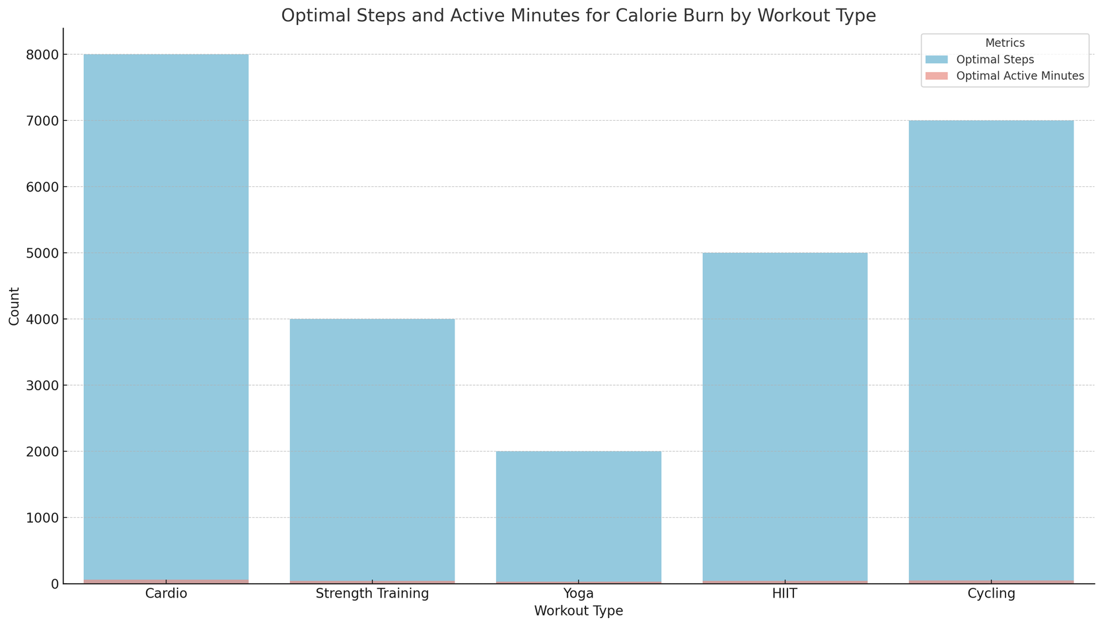
Q4. For each workout type, what is the optimal range of steps/active minutes to maximize calorie burn without excessively elevating heart rate?

Slide 16
Key Observations from the Plot
Workout Type-Specific Insights:
1. Cardio:
• Ideal for maximizing calorie burn with consistent movement.
• Ensure heart rate monitoring to avoid overexertion during prolonged sessions.
2. Strength Training:
• Focus on combining strength exercises with short, active intervals to optimize calorie burn.
• Encourage recovery periods to balance heart rate.
3. Yoga:
• Effective for flexibility and relaxation rather than calorie-intensive workouts.
• Combine with other workouts to enhance calorie burn if needed.
4. HIIT:
• Best for short-duration, high-intensity calorie burn.
• Monitor for overexertion, particularly in individuals with lower fitness levels.
5. Cycling:
• Offers consistent calorie burn with minimal impact on joints.
• Optimize resistance levels for better results without heart rate spikes.

Slide 17
Next Steps and Deeper Analysis
Potential Areas for Further Analysis:
1. Heart Rate Data:
Analyze heart rate trends for each workout type to refine optimal zones.
2. Calorie Burn Efficiency:
Compare calories burned per step/minute across workout types.
3. Personalized Workout Plans:
• Develop tailored recommendations based on fitness levels and goals.
Actionable Plans:
1. Promote workout diversity by combining step-intensive workouts (e.g., Cardio) with low-impact options (e.g., Yoga).
2. Design fitness programs targeting specific calorie burn goals while maintaining safe heart rate levels.

Slide 18
Methodology
Objective: Study the optimal range of steps/active minutes to maximize calorie burn without excessively elevating heart rate for each workout type.
Data: Collect data on workout duration (steps/active minutes), calorie burn, and heart rate levels for various workout types (e.g., walking, running, cycling, strength training).
Preparation: Group workout types by intensity (low, moderate, high) and normalize data to account for factors like age, weight, and fitness level.
Visualization: Use line charts for calorie burn vs. active minutes/steps, scatter plots to show heart rate vs. activity level, and shaded regions to indicate the optimal range for each workout type.
Insights: Highlight the optimal duration (steps/active minutes) for each workout type where calorie burn is maximized while keeping heart rate within a safe zone (50-85% of max heart rate).

Slide 19
Next Steps and Deeper Analysis
Potential Areas for Further Analysis:
1. Heart Rate Data:
Analyze heart rate trends for each workout type to refine optimal zones.
2. Calorie Burn Efficiency:
Compare calories burned per step/minute across workout types.
3. Personalized Workout Plans:
• Develop tailored recommendations based on fitness levels and goals.
Actionable Plans:
1. Promote workout diversity by combining step-intensive workouts (e.g., Cardio) with low-impact options (e.g., Yoga).
2. Design fitness programs targeting specific calorie burn goals while maintaining safe heart rate levels.

Slide 20
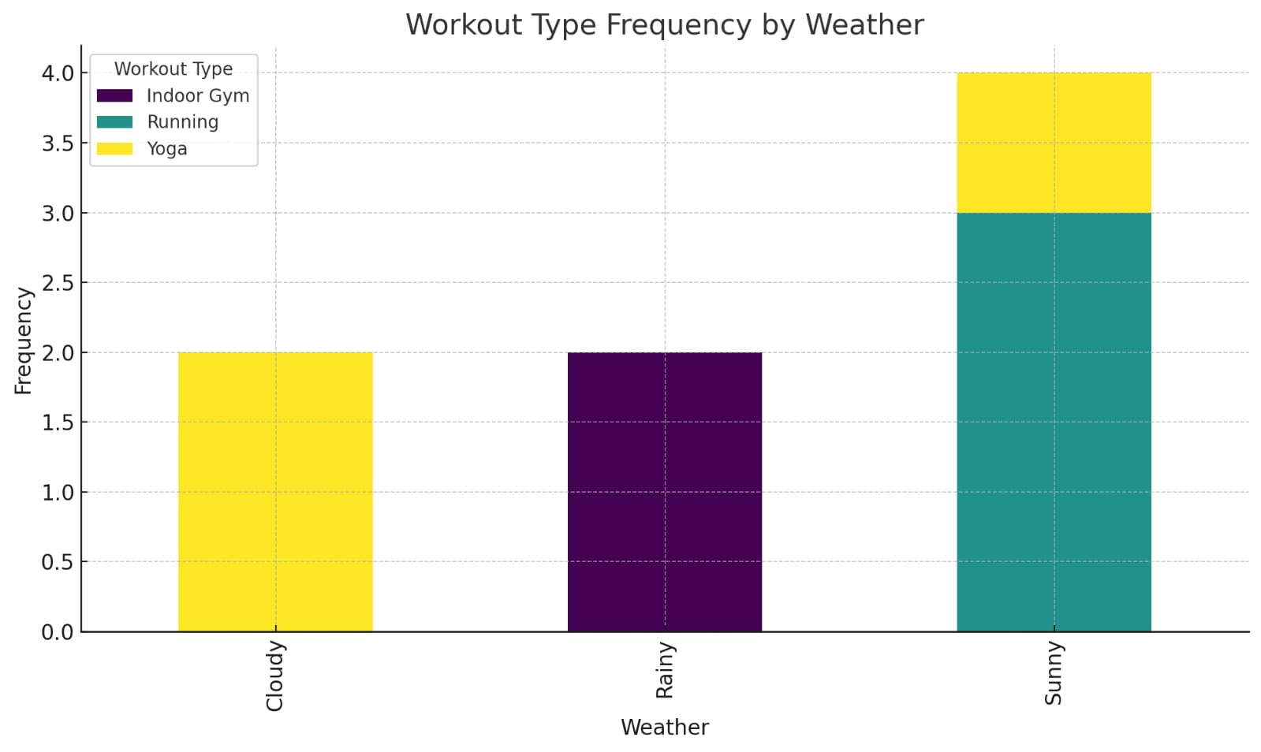
Q5. Does weather influence the choice of workout type or location, and how do these choices subsequently affect mood and physical activity metrics?

Slide 21
Key Observations from the Plot
Sunny Weather:
Yoga is the most frequent workout choice, possibly due to favorable outdoor conditions.
Diverse options like yoga and running are more prominent compared to other weather conditions.
Cloudy Weather:
Running is preferred, indicating moderate outdoor activity levels.
Limited diversity in workout types compared to sunny weather.
Rainy Weather:
Indoor gym workouts are the dominant choice, reflecting the impact of weather on outdoor activity limitations.
Lack of outdoor activities could affect overall engagement with physical activity.

Slide 22

Next Steps:
1.Mood and Energy Tracking:
Correlate weather, workout types, and their impact on participants' mood and energy levels.
Gather feedback on perceived satisfaction with workouts under varying weather conditions.
2.Activity Frequency Analysis:
Collect data over a longer period to observe seasonal variations in workout preferences.
Evaluate the consistency of workout routines under extreme weather patterns.
3.Demographic Insights:
Segment data by age, gender, and fitness goals to identify specific trends.
Understand if particular groups show stronger preferences for certain workout types in specific weather.

Slide 23
Deeper Analysis:
1.Physical Metrics:
Analyze calorie expenditure, heart rate, or step counts to quantify the effectiveness of different workouts.
Compare physical activity metrics between indoor and outdoor settings.
2.Weather Intensity Impact:
Investigate how varying intensities of weather (e.g., heavy rain vs. light rain) affect workout preferences.
Assess whether extreme weather leads to a complete drop in physical activity levels.
3.Longitudinal Mood Analysis:
Track mood changes before and after workouts under different weather conditions.
Determine if sunny or outdoor activities contribute more to mood enhancement compared to indoor activities.

Slide 24
Methodology
Objective: Study how weather influences workout choices and locations, and its subsequent impact on mood and physical activity metrics.
Data: Collect data on weather conditions (e.g., temperature, humidity, rain), workout types, workout locations (indoor vs. outdoor), mood scores, and physical activity metrics (steps, active minutes, calorie burn).
Preparation: Categorize weather conditions (e.g., sunny, rainy, cold, hot), group workout locations (indoor, outdoor), and normalize mood and activity data to account for external factors.
Visualization: Use bar charts for workout choices by weather type, scatter plots for mood vs. activity levels by location, and heatmaps to show correlations between weather, workout type, and mood.
Insights: Identify weather patterns that encourage outdoor vs. indoor workouts, highlight the mood-boosting effects of outdoor activity, and analyze how different weather conditions affect physical activity and mood outcomes.

Slide 25





Thank you!
Team DataMorphers
Team Leader :Prashant Ranjan (24MC3035)
Members :
1. Jayant Raj Verma (24MC3022)
2. Saket Suman (24EC3029)
3. Baldev Singh Jadon (24MC3012)

